Slide 1
Wanderlust Plan your Travel Itinerary
- Using open source LLMs and custom dataset
Team:
Shreyash Zanjal
Vedanvita Gudavalli
Kritika Satisha

Slide 2
Table of contents
01
02
03
04
05
06
Market Research
About
Wanderlust?
What sets
us apart
Demo
Dataset
Model Selection

Slide 3
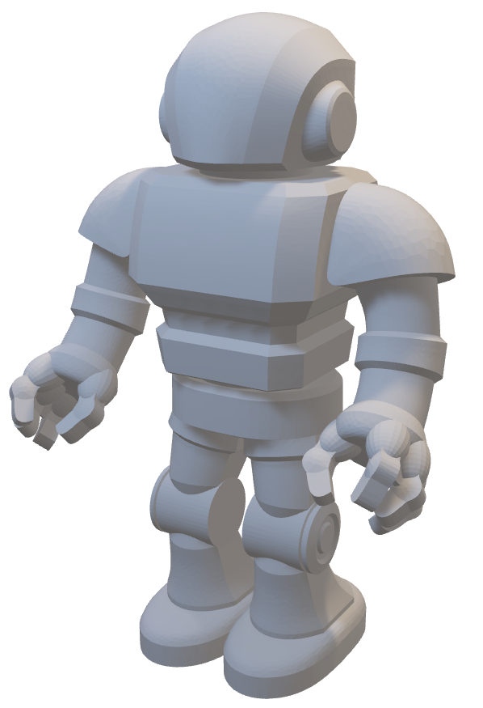
About me
Hi, I am Wanderlust, your travel assistant
Aims to build a unique community of people including travelers, vloggers, influencers, etc. with similar interests
People will chat with me and ask suggestions. I will suggest Themed Restaurants, Parks, Museums, National Parks, Movies, etc.
My friend Google API will help you for getting Routes, Optimal Directions, Place details with reviews, etc.

Slide 4
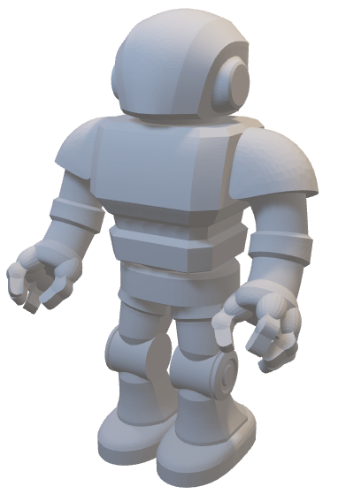
What sets me apart?
Tailored Recommendations
Real-time interaction
Trusworthy Suggestions
My preferences are based on upcoming themes, previous trips, and interactive history and much more.
I give users the feel of conversing with a travel agent >>>>> navigating through reviews and forums
Iam continously updating my knowledge base based on blogs, experiences that people share.

Slide 5
Market Research

Slide 6
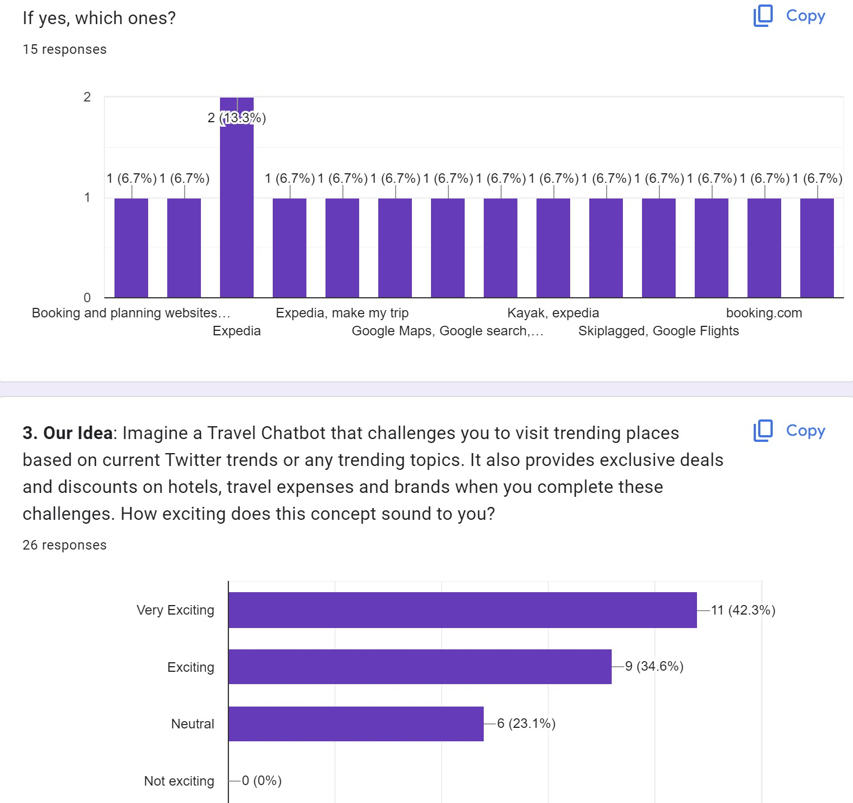
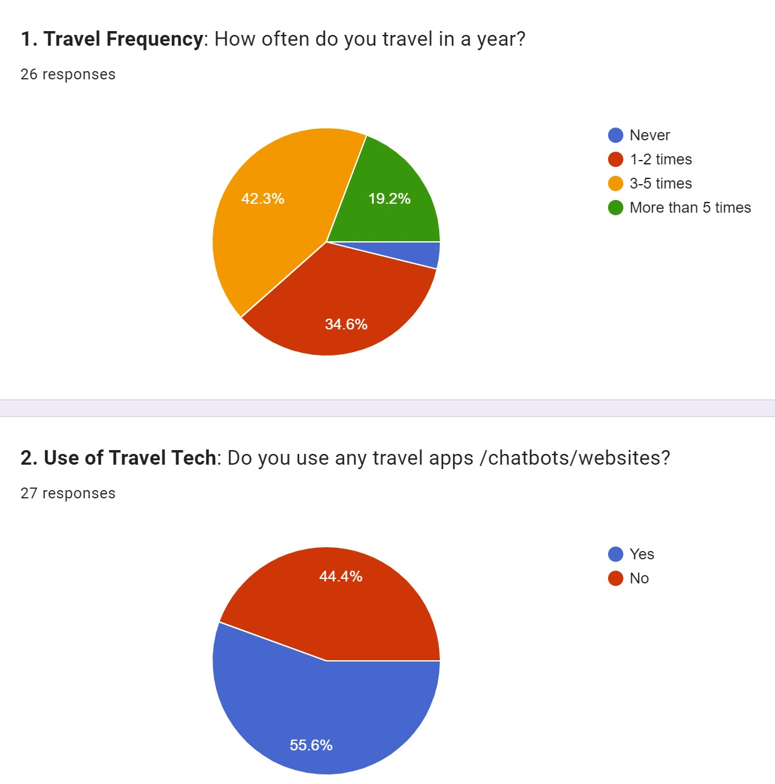
Google forms

Slide 7
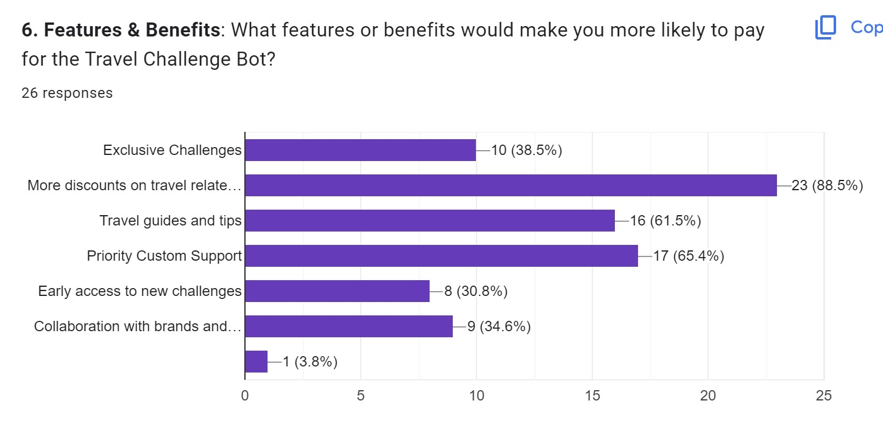
Google forms

Slide 8
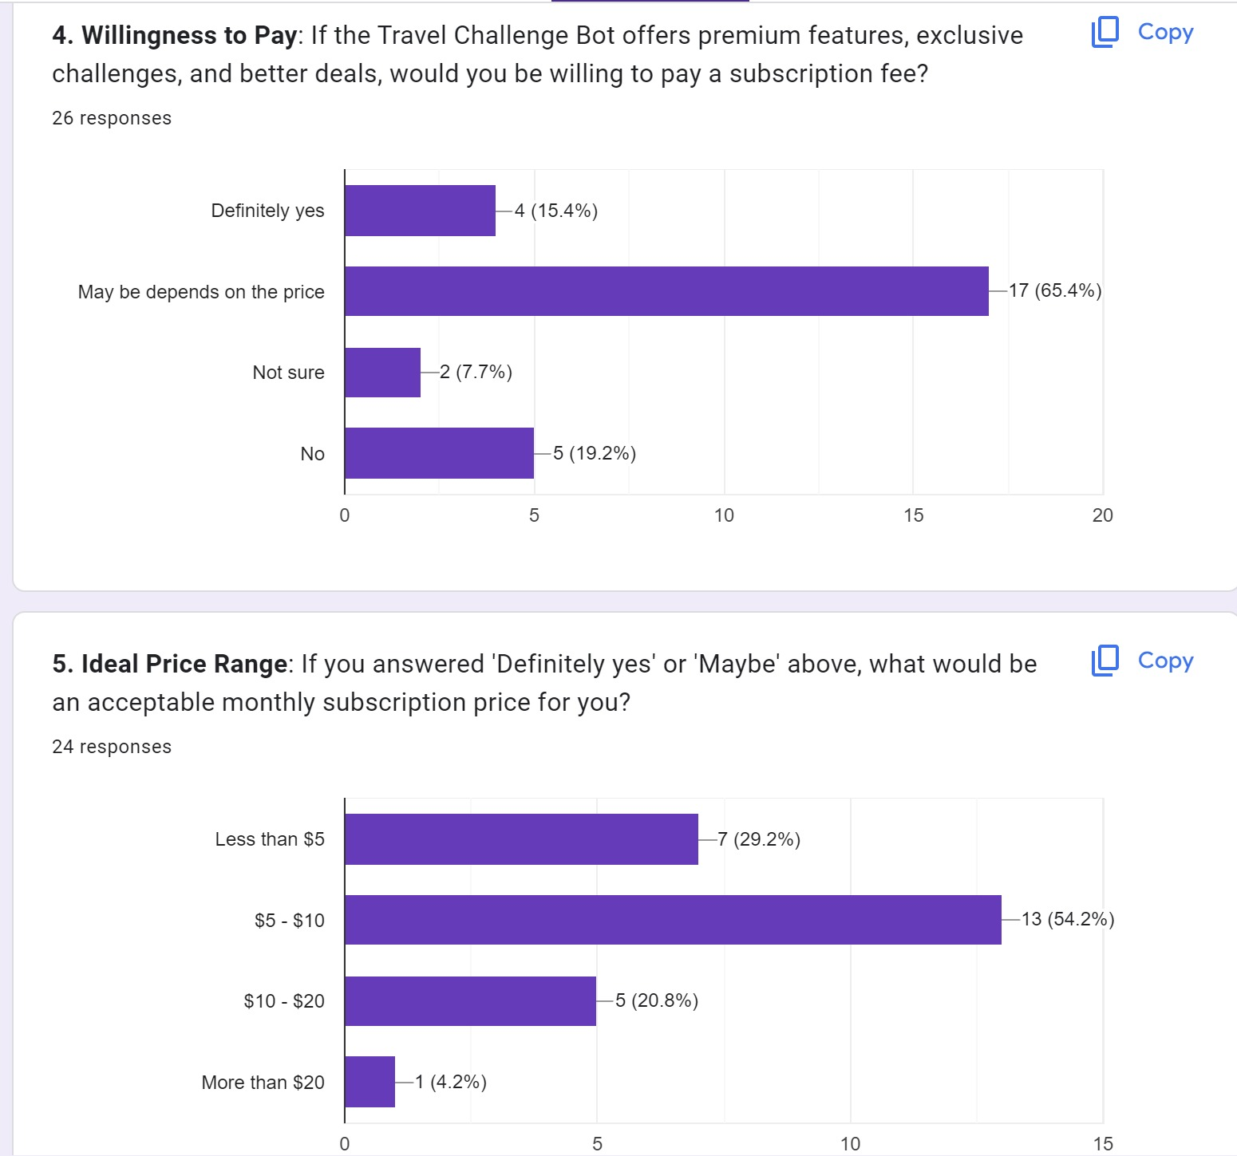
Google forms

Slide 9
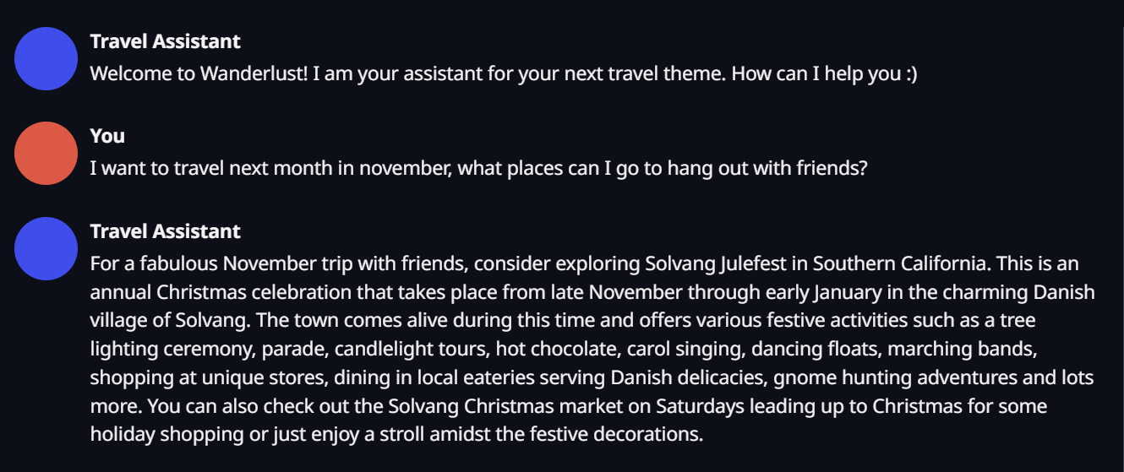
Phase 1
Based on the data collected from on the travel blog post - 13+ Ways to Celebrate Julefest - Solvang Christmas 2023 (theplaceswherewego.com)

Slide 10
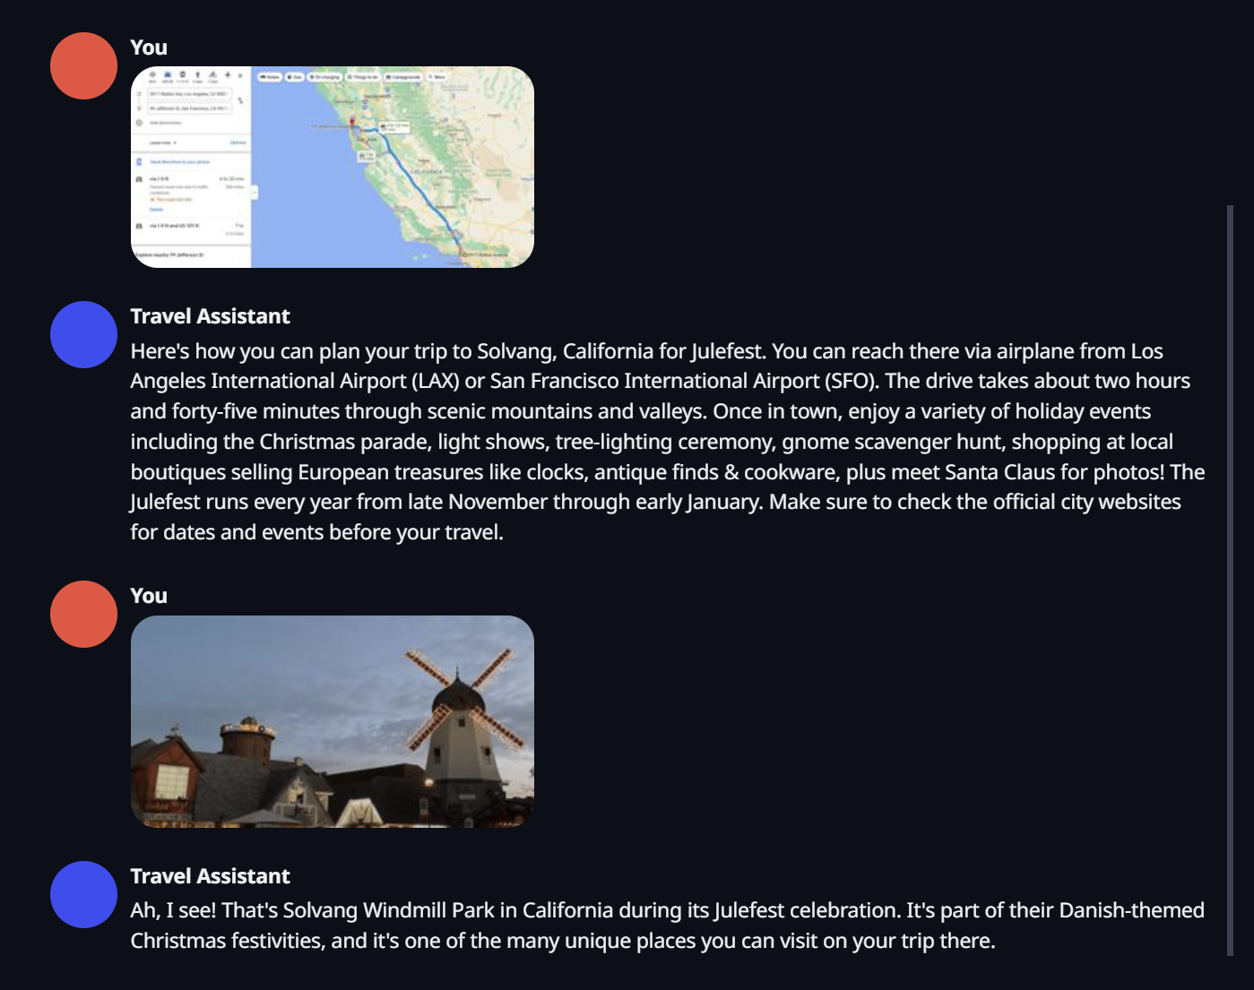

Slide 11
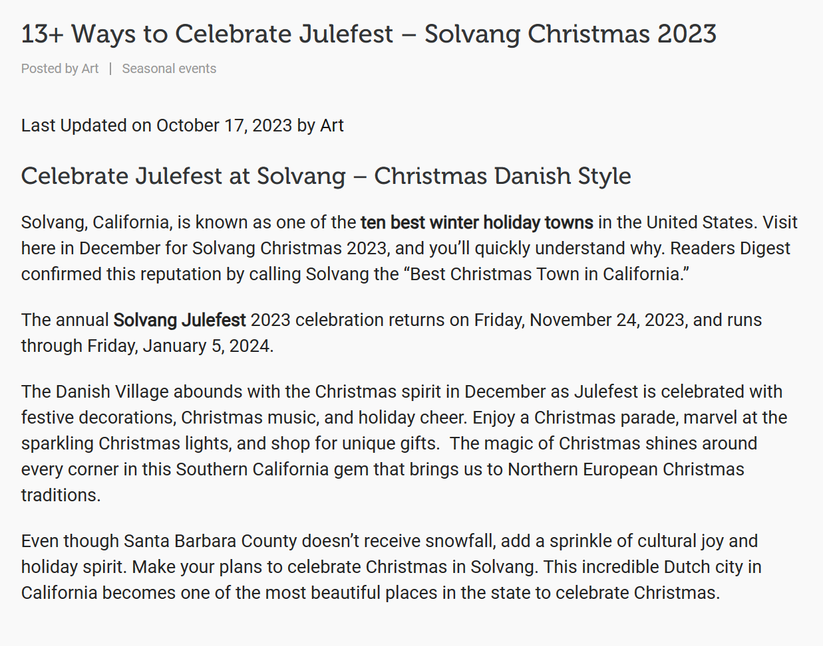

Slide 12
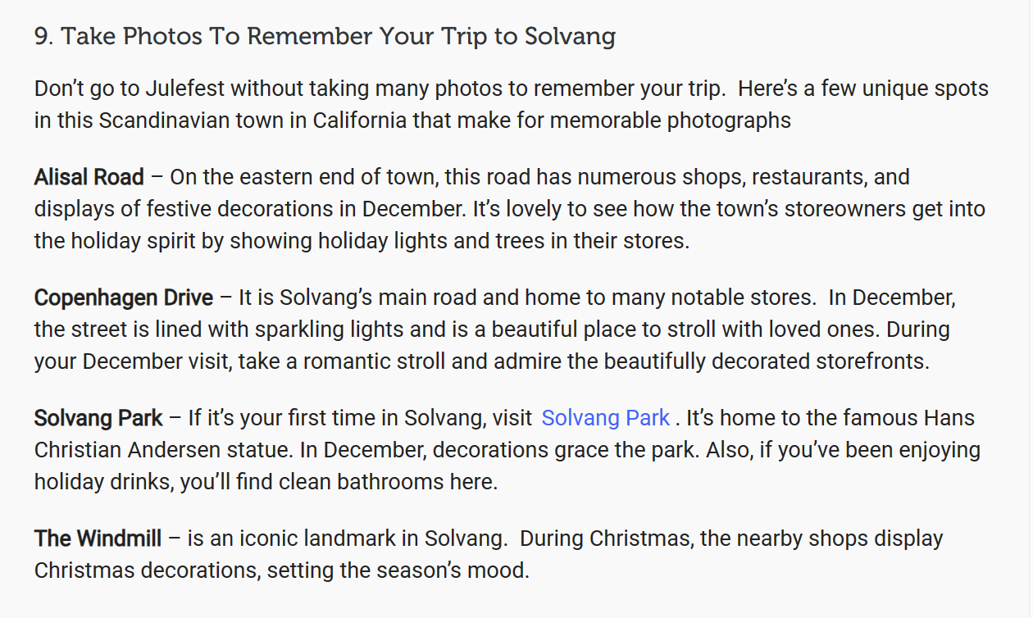

Slide 13
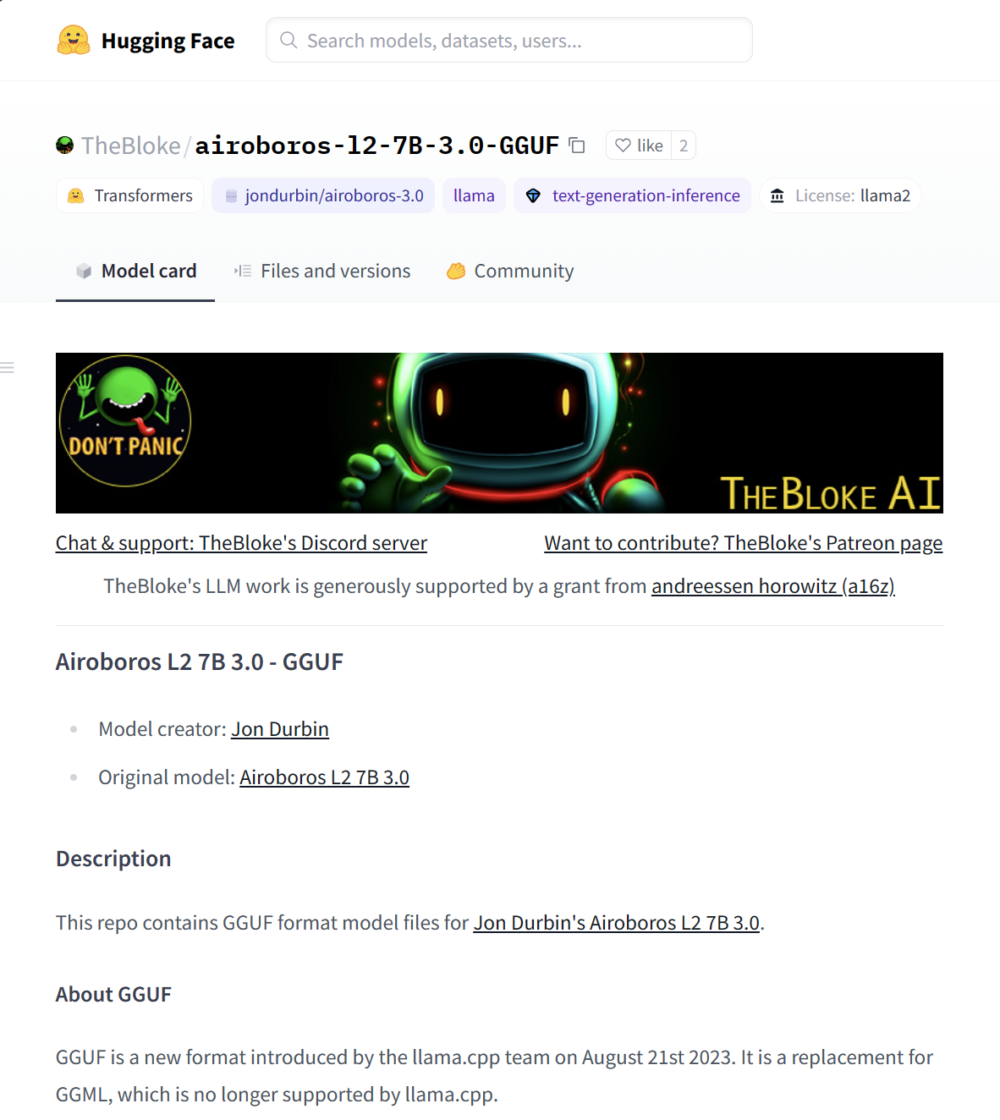
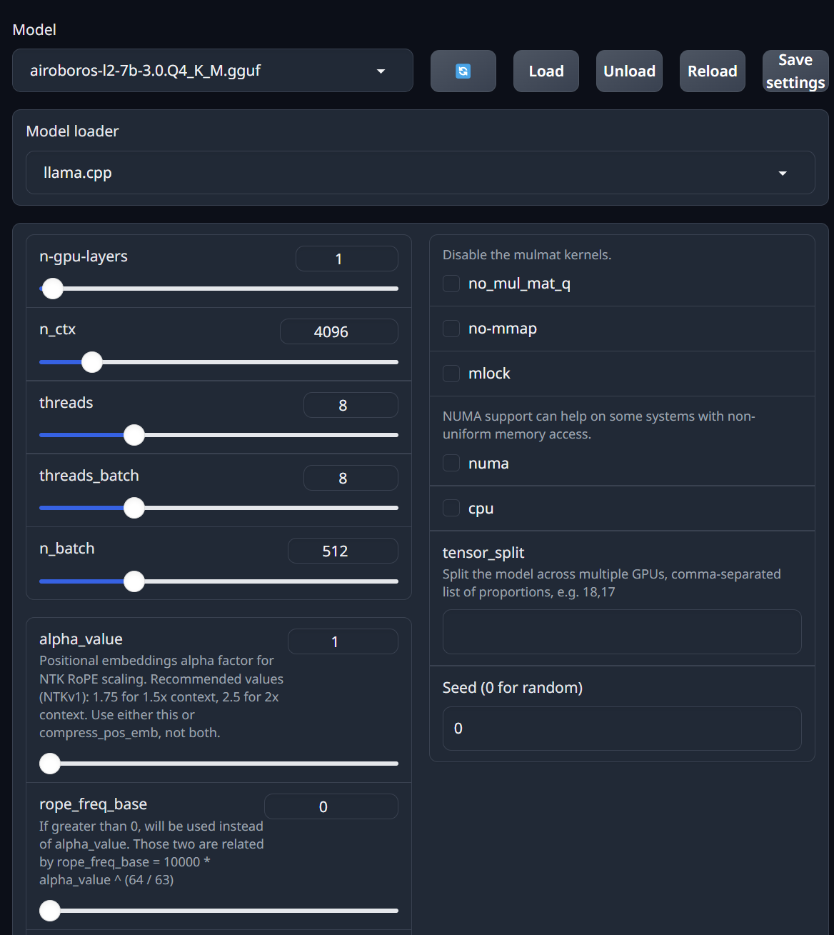
Model Selection

Slide 14
Planned implementation
Google API
Role-Based
Generate routes and real-time information about places
(Try) Auto gen capabilities for creating AI Agents
Today
Next
Next
Next
Model Selection
Widening Dataset
Supports image input! Using airoboros 7B model
Adding real-time scrapping, and more data sources

Slide 15
Thanks!
Team Wanderlust

